Slide 1
CAI4702 — IoT & AI Integration
Industrial IoT
Predictive Maintenance
Machine Fault Detection using Random Forest
Dataset: AI4I 2020 — 10,000 IoT Readings | Model: Random Forest + SMOTE
Accuracy: 95.86% | Fault Recall: 89% | Missed Faults: 6 out of 53
Arab Academy for Science and Technology and Maritime Transport

Slide 2
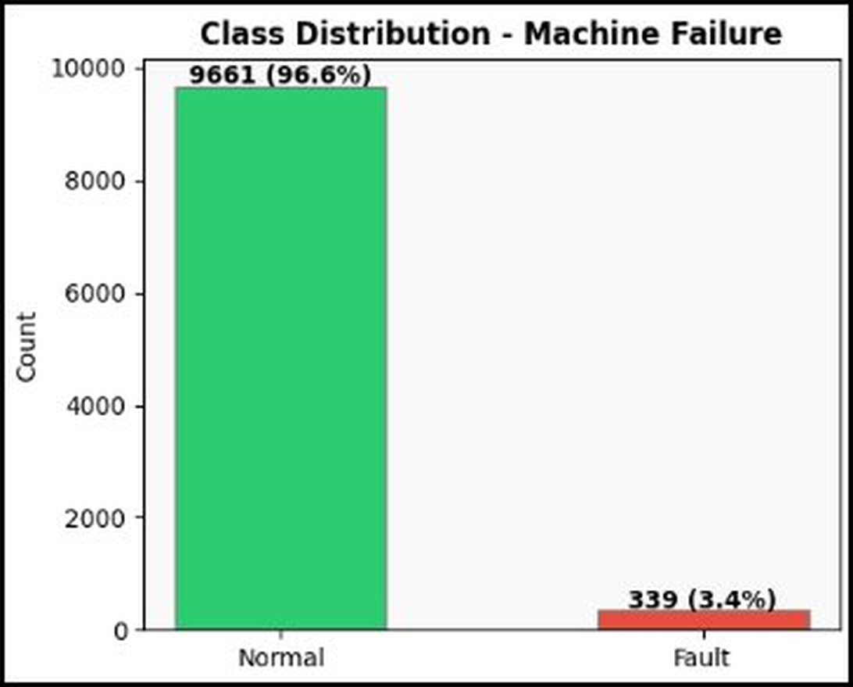
Dataset — AI4I 2020 Predictive Maintenance
10,000
7
3.4%
UCI
Sensor Readings
Features Used
Fault Rate
Data Source
Sensor Features:
Class Balance:
Feature | Unit | Role
Air Temperature | K | Sensor input
Process Temperature | K | Sensor input
Rotational Speed | RPM | Sensor input
Torque | Nm | Sensor input
Tool Wear | min | Sensor input
Machine Failure | 0 / 1 | TARGET ← predict this

Slide 3
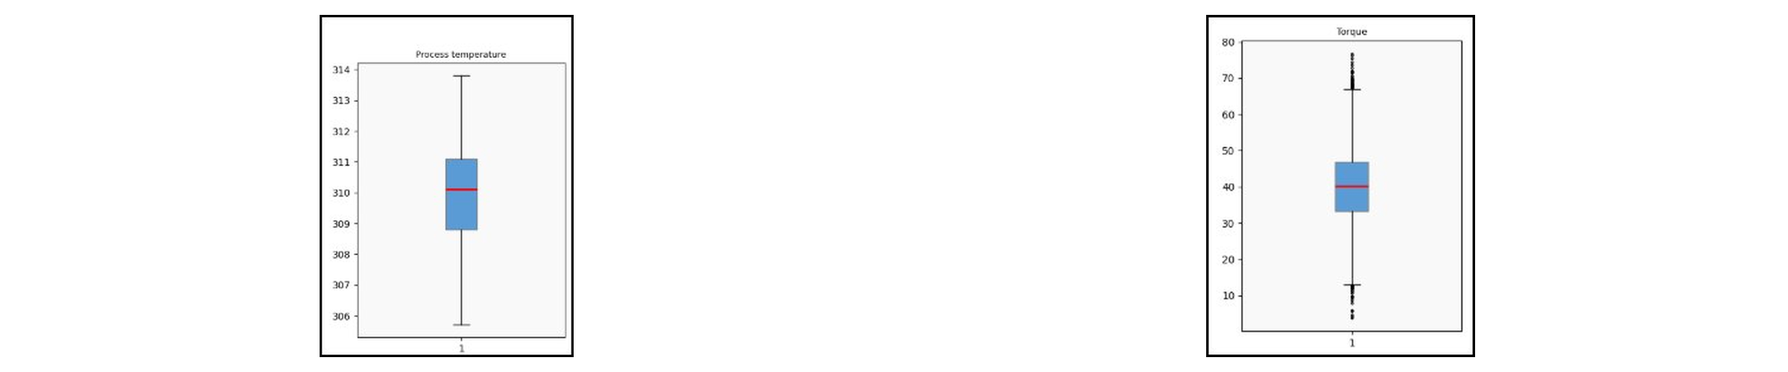
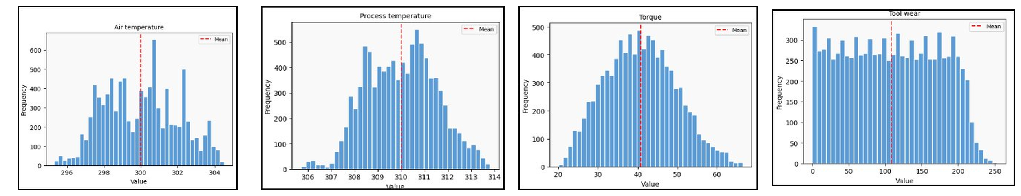
Data Analysis — Outlier Detection & Distributions
Boxplots — Before Outlier Removal:
Feature Distributions — After Outlier Removal (9,535 rows):

Slide 4
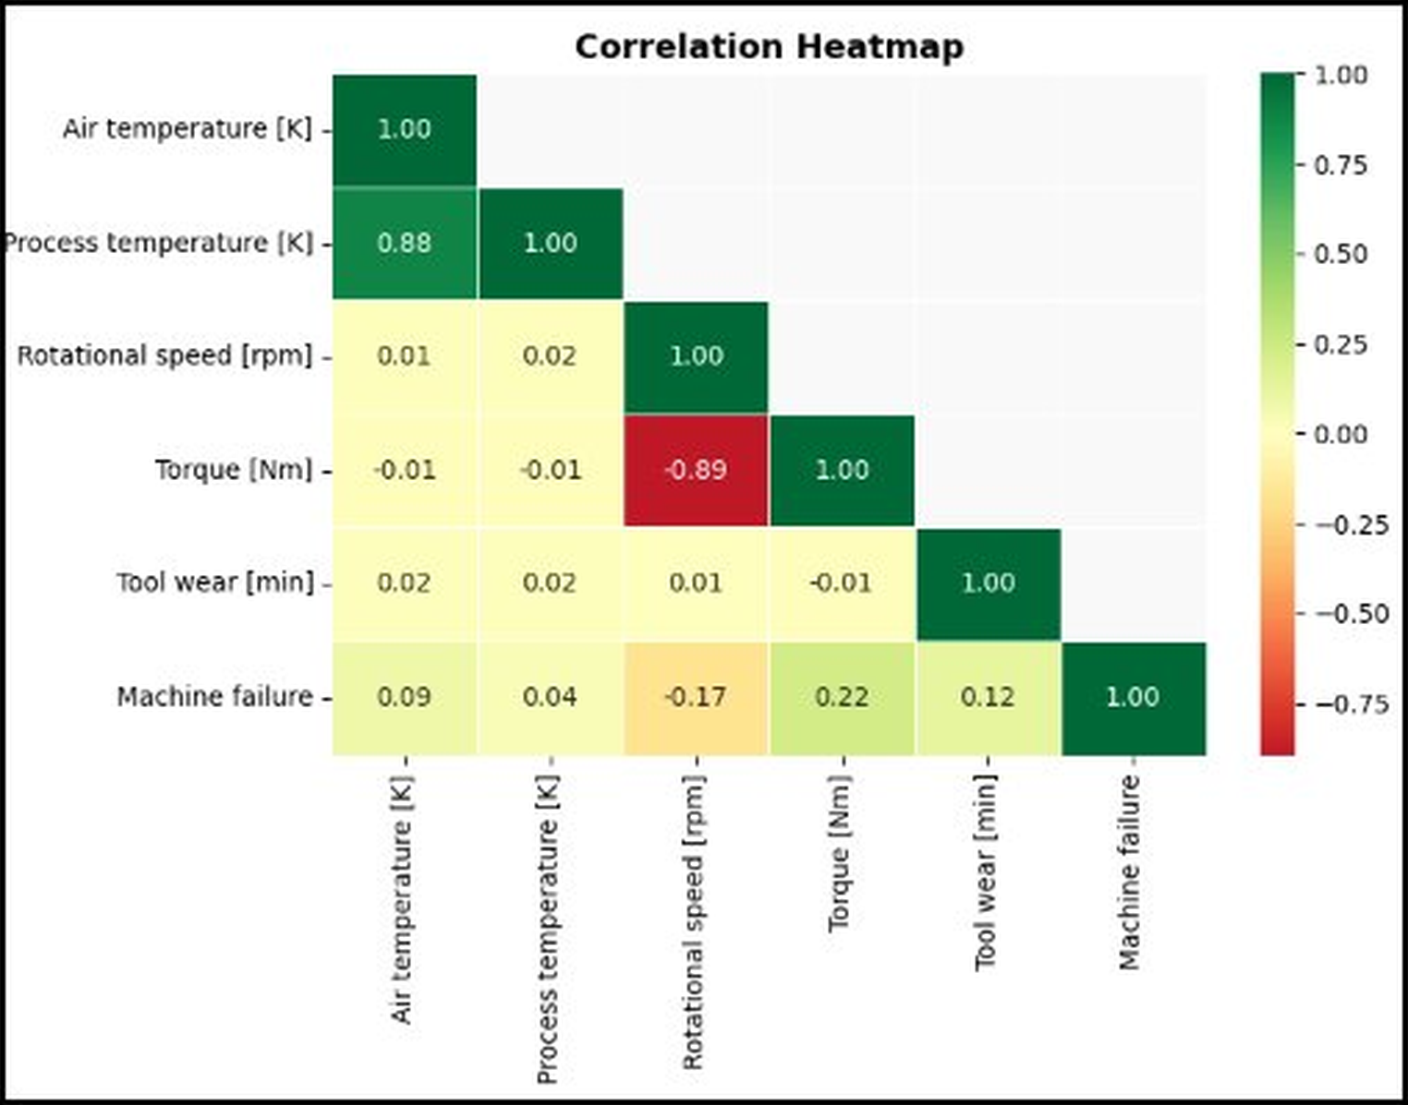
Correlation Heatmap — Sensor Relationships
Key Observations:
🔥 Air & Process Temp highly correlated (0.88)
⚡ Torque & RPM strongly negative (-0.89)
⚠️ Torque has highest link to failure (+0.22)
📉 Rotational speed negative link (-0.17)
🛠️ Tool wear also related to failure (+0.12)

Slide 5
Feature Engineering
Encode Type Column
Create Power Feature
01
L / M / H → 0 / 1 / 2
ML models need numbers not text
02
Power = Torque × RPM
Combines 2 sensors into 1 meaningful signal
StandardScaler
Train / Test Split
03
All features scaled to same range
Prevents large values dominating the model
04
80% Training (7,628) | 20% Testing (1,907)
stratify=True keeps same fault ratio

Slide 6
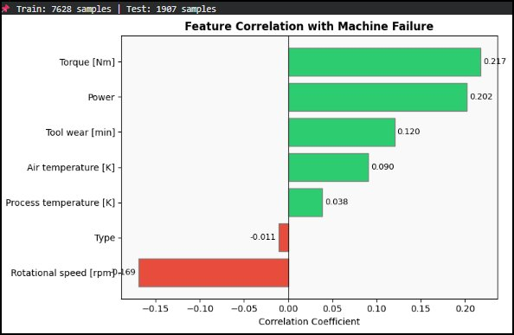
Feature Correlation with Machine Failure
Interpretation:
Torque (0.217) — strongest positive signal
Power (0.202) — engineered feature works!
Tool Wear (0.120) — wear time matters
Air Temperature (0.090) — moderate link
Rotational Speed (-0.169) — inverse link

Slide 7
AI Model — Random Forest + SMOTE
Problem: Class Imbalance
Why Random Forest?
Before SMOTE:
Normal: 7,418 | Fault: 210
After SMOTE:
Normal: 7,418 | Fault: 7,418 ✅
▸ 100 decision trees (n_estimators=100)
▸ Max depth=10 to prevent overfitting
▸ Works well with imbalanced data
▸ Gives feature importance scores
Flow: Raw Data → Clean → SMOTE → Train RF → Predict → Evaluate
9,535
7,628
1,907
14,836
Total Rows
Train (80%)
Test (20%)
After SMOTE

Slide 8
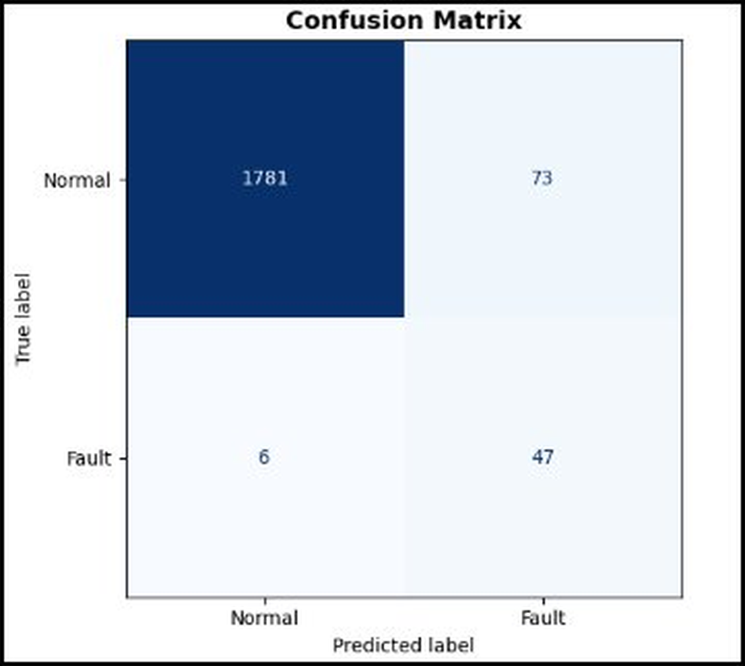
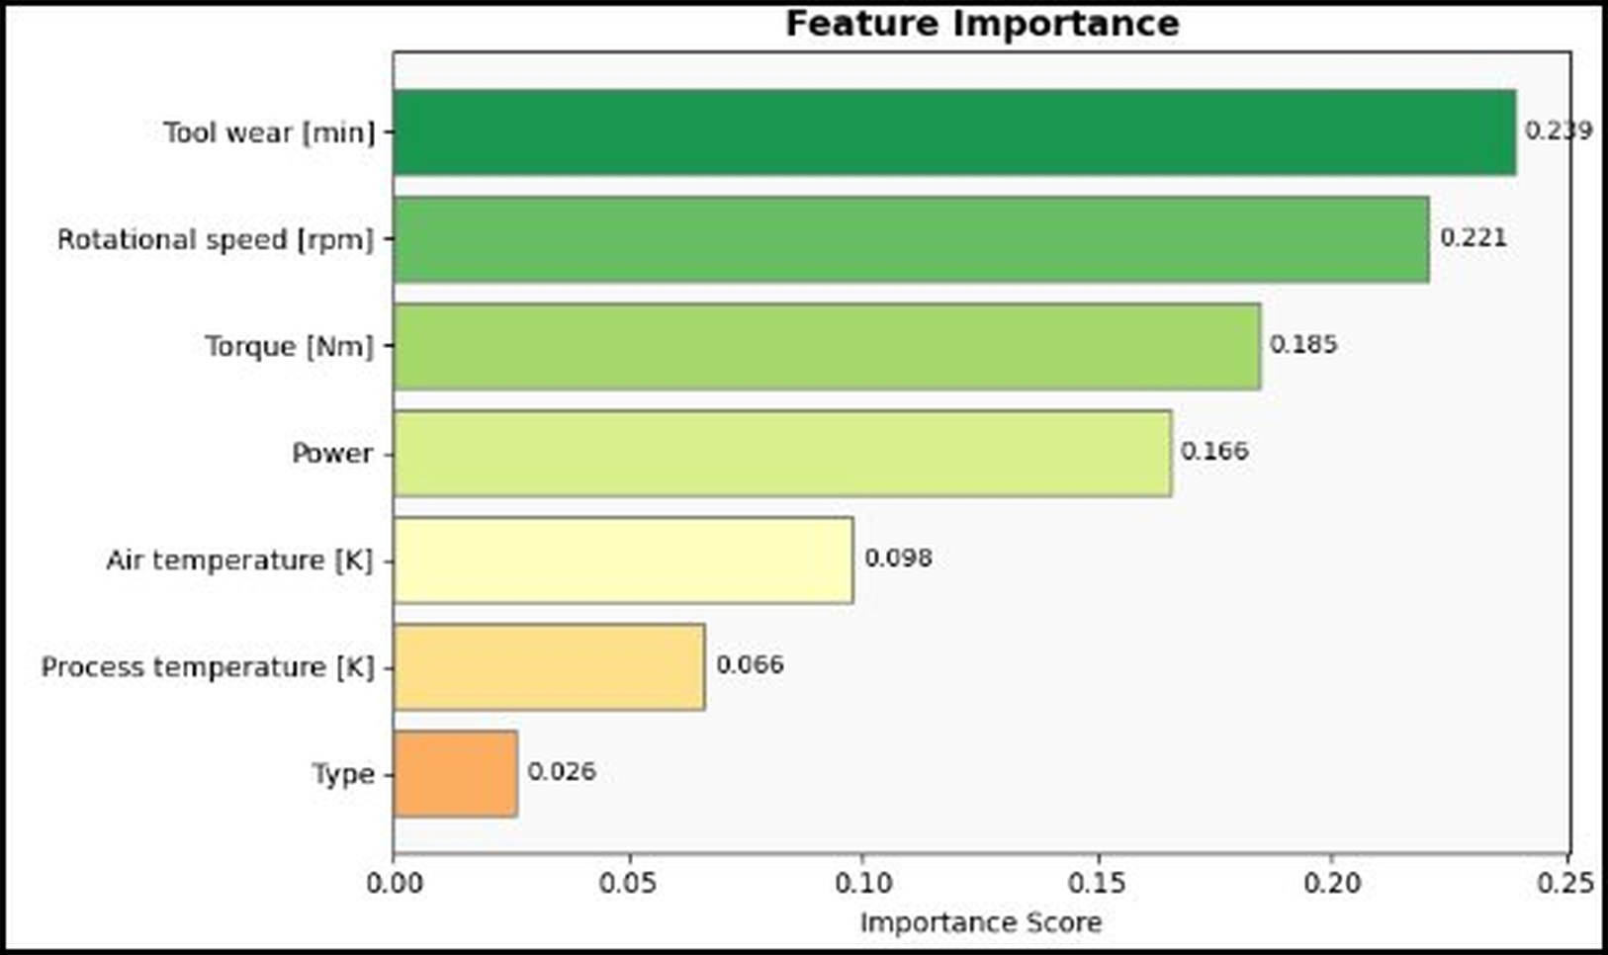
Model Evaluation Results
95.86%
89%
6
47
Accuracy
Fault Recall
Missed Faults
Caught Faults
Confusion Matrix:
Feature Importance:

Slide 9
Key Insights
🔧 Tool Wear = #1 Predictor (0.239)
⚡ Rotational Speed = #2 (0.221)
01
The longer a tool runs without replacement, the higher the failure risk. Factories should schedule maintenance based on tool wear time.
02
Abnormal RPM is a strong fault signal. Negative correlation means unusual speed drops are dangerous.
💪 Torque & Power (0.185 / 0.166)
🌡️ Class Imbalance Challenge
03
High torque combined with low speed = machine overload. The engineered Power feature proved very useful.
04
Only 3.4% of data was Fault. Without SMOTE the model would ignore faults completely. SMOTE balanced classes to 50/50.

Slide 10
Real-World Application in Factories
📡 Continuous Monitoring
🚨 Early Warning System
1
IoT sensors collect temperature, torque, RPM, and tool wear every second from machines on the factory floor.
2
When model predicts Fault, an alert is sent immediately to the maintenance team BEFORE the machine breaks down.
💰 Cost Savings
📅 Smart Scheduling
3
Unplanned downtime costs thousands per hour. Predictive maintenance reduces downtime by up to 50%.
4
Instead of fixed maintenance schedules, machines are serviced ONLY when sensors indicate it is needed.
Result: 95.86% Accuracy | 89% Fault Recall | Only 6 faults missed out of 53

Slide 11
Project Summary
Industrial IoT — Predictive Maintenance
✅ Loaded and explored 10,000 real IoT sensor readings from UCI repository
✅ Cleaned data: removed 465 outliers using IQR method
✅ Created Power feature (Torque × RPM) — improved model performance
✅ Handled imbalance with SMOTE: balanced 210 faults to 7,418
✅ Trained Random Forest: 95.86% accuracy on unseen test data
✅ Fault Recall = 89% — model catches most real faults early
✅ Tool Wear is the #1 predictor — key signal for maintenance scheduling
Thank you | Questions?

